Slide 1



Risk Assessment Awareness Training
Notes:
The abstract pattern can be removed or repositioned if required. Be careful to ‘Send to Back’ so that it does not obscure any important information.

Slide 2
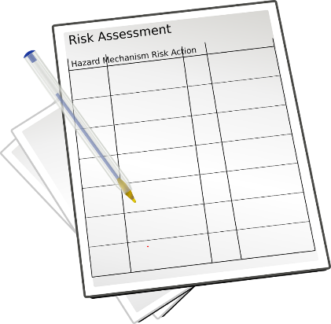
Session objectives
Refresh the principles of risk assessment
What makes a RA ‘suitable and sufficient’?
Good ole horror stories
Evotix Assure *live*

Slide 3

Motivations for safety management
We need to – moral and aspirational reasons
We have to – legal reasons
We should – financial reasons
We want to – develop and protect our reputation

Slide 4
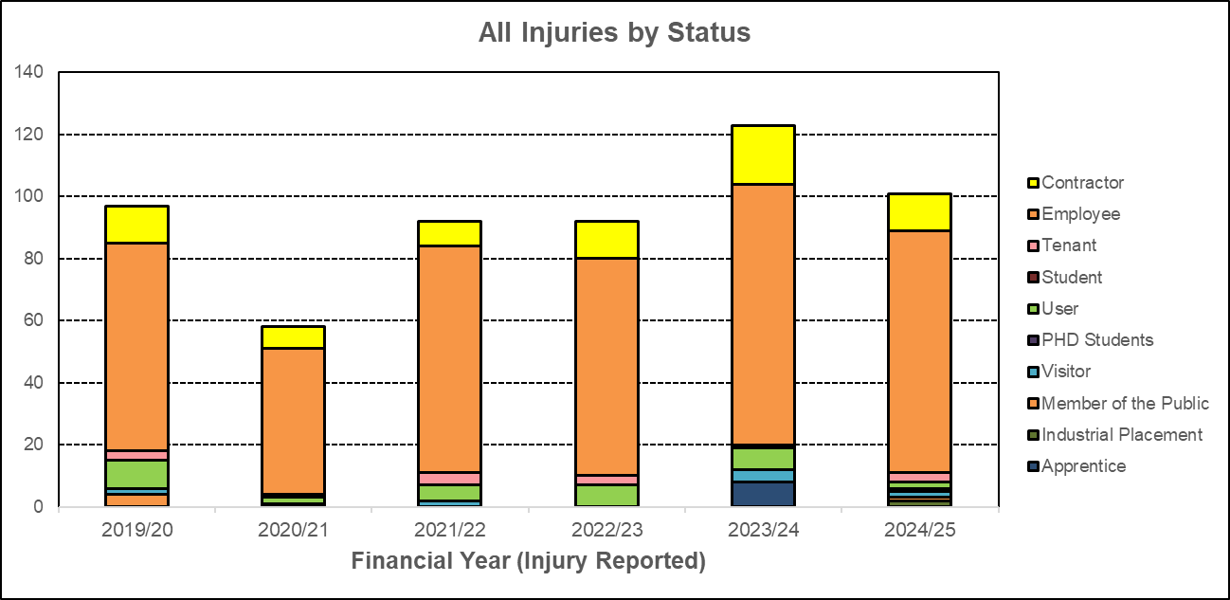
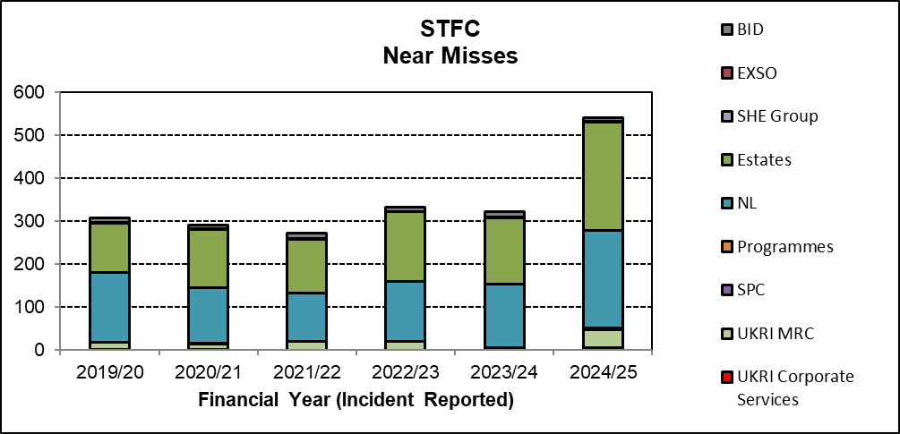
STFC Incident data
Injuries Near misses (learning opportunities)

Slide 5
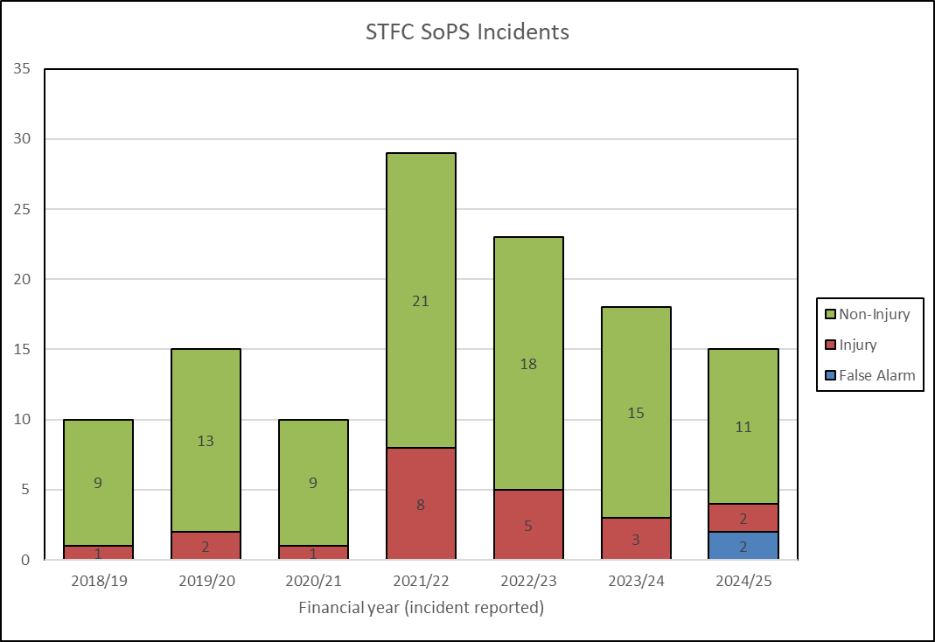
Serious or Potentially Serious Incidents
(SoPs)
Incidents (injuries, near misses, vehicle incidents, fire incidents) that did, or had the reasonable potential to result in significant and permanent harm to staff, contractors, tenants, users, visitors at STFC sites or for staff while travelling and working on Council business away from STFC sites

Slide 6

Risk assessment
3(1) Every employer shall make a suitable and sufficient assessment of -
  (a) the risks to the health and safety of his employees to which they are exposed whilst they are at work; and
  (b) the risks to the health and safety of persons not in his employment arising out of or in connection with the conduct by him of his undertaking,
(2) Every self-employed person shall make a suitable and sufficient assessment of -
(a) the risks to his own health and safety to which he is exposed whilst he is at work; and
(b) the risks to the health and safety of persons not in his employment arising out of or in connection with his undertaking, for the purpose of identifying the measures he needs to take to comply with the requirements and prohibitions imposed upon him by or under the relevant statutory provisions.
(3) Any assessment such as is referred to in paragraph (1) or (2) shall be reviewed by the employer or self-employed person who made it if -
(a) there is reason to suspect that it is no longer valid; or
(b) there has been a significant change in the matters to which it relates; and where as a result of any such review changes to an assessment are required, the employer or self-employed person concerned shall make them.
(4) An employer shall not employ a young person unless he has, in relation to risks to the health and safety of young persons, made or reviewed an assessment in accordance with paragraphs (1) and (5).
(5) In making or reviewing the assessment, an employer who employs or is to employ a young person shall take particular account of -
(a) the inexperience, lack of awareness of risks and immaturity of young persons;
(b) the fitting-out and layout of the workplace and the workstation;
(c) the nature, degree and duration of exposure to physical, biological and chemical agents;
(d) the form, range, and use of work equipment and the way in which it is handled;
(e) the organisation of processes and activities;
(f) the extent of the health and safety training provided or to be provided to young persons; and
(g) risks from agents, processes and work listed in the Annex to Council Directive 94/33/EC(1) on the protection of young people at work

Slide 7
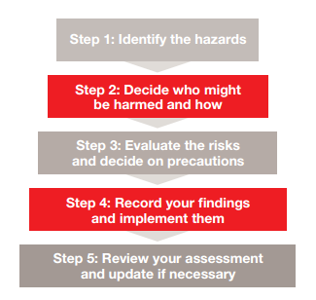

HSE 5 steps to risk assessment
You may see all types of RA in your role. However, all models must meet this criteria to be “suitable and sufficient”
Time, money and effort should be proportionate to the level of risk

Slide 8
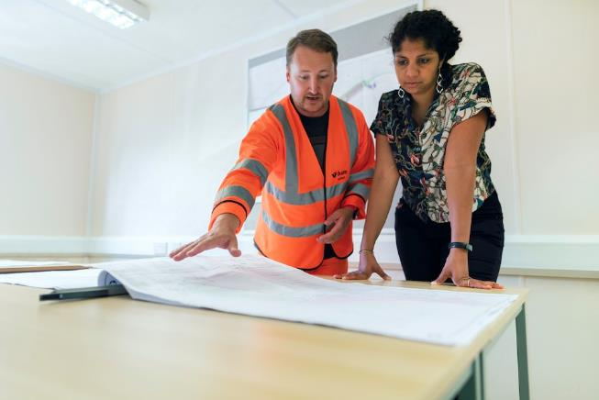
Different types of risk assessment
This course focuses on activity risk assessments but there are other types:
Dynamic
COSHH for chemicals
DSEAR
Design
PEEP
Machinery
Personal
Notes:
Depends on the overall aim

Slide 9
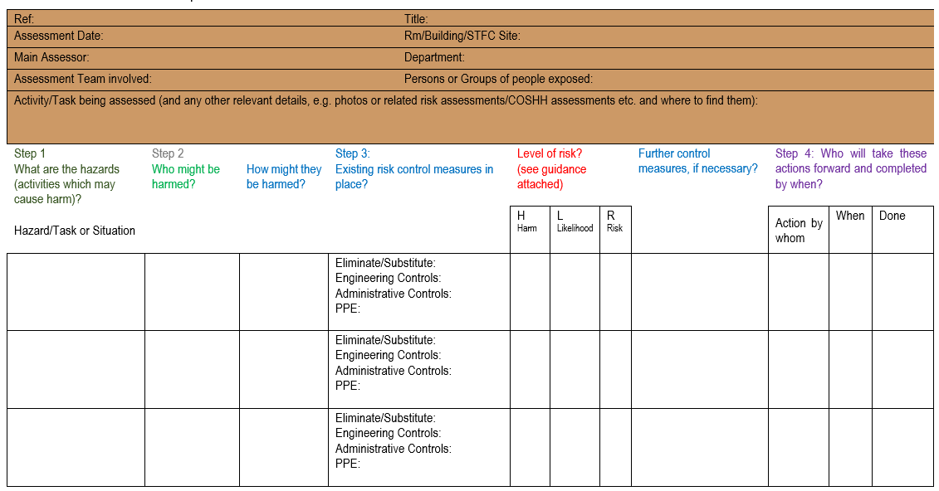
STFC activity Risk assessment proforma

Slide 10
SHE Code 6: Risk Management
A HAZARD is anything that has the potential to cause harm. Types:
Physical safety hazards such as working with electricity or working from ladders
Health hazards such as working with hazardous chemicals, biological agents or allergenic materials. There are also, psychosocial hazards that could lead to work-related mental ill-health issues such as stress, anxiety or depression; or activities where staff may be subject to violence or aggression (e.g. front line, customer or public facing staff)
Environmental hazards such as activities leading to harmful emissions to atmosphere or contamination of our waste water systems

Slide 11

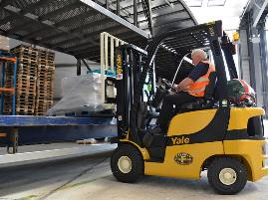


Definitions - Hazard
A hazard is any activity or object that has the potential to cause harm to people or the environment.
Examples:
  Working at height
  Manual handling
  Working with syringes
  Driving a fork lift truck
  Operating 3D printer
  Use of mains electricity to power ‘x’ equipment
  Working with liquid nitrogen
  Working ‘out of hours’
  Working from home
Clue: A hazard never sounds painful!
You will need to research your hazards to identify all significant hazards. You can use: observation of activity; operator consultation; websites, e.g. HSE; Manufacturer’s instructions; internal/external experts; incidents/near misses; etc.

Slide 12
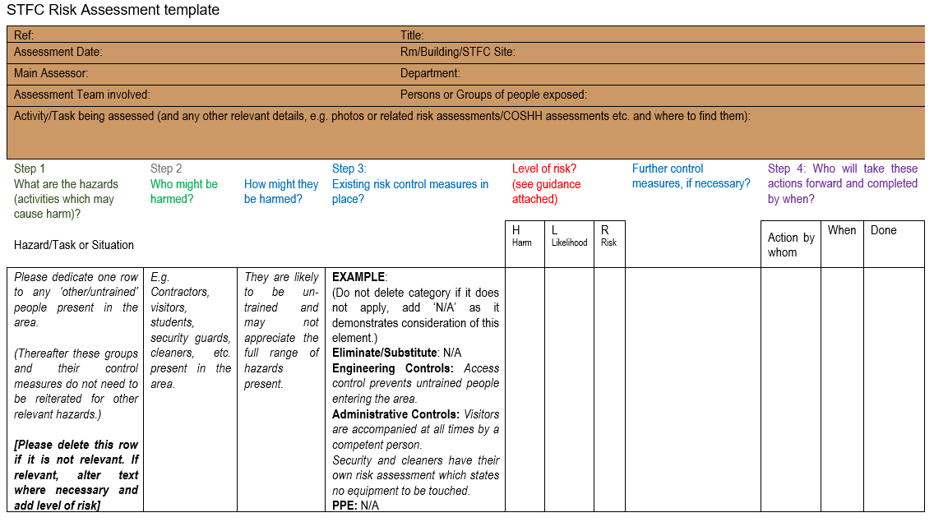
How to address other/untrained people in RA

Slide 13
Definitions
Harm (saying ‘injured’ is not sufficient)
  How the hazard could cause injury. In order to be specific, detail the pathway to the body, e.g:
    skin contact causing burns
    hit by projectile after explosion
    asphyxiation after inhaling nitrogen
    cut by sharp object
    absorbed through skin, etc.

Slide 14
Hierarchy of control measures
1. Eliminate
Most
Preferred
2. Substitute
3. Engineering Controls
Least
Preferred
4. Administrative Controls
5. Personal Protective Equipment

Slide 15
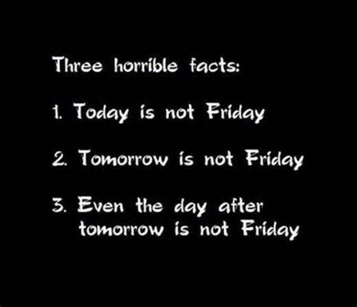
Language to describe control measures
Risk assessments are a factual account of what is in place to protect safety. Avoid use of words and phrases such as:
          Where possible staff will be provided with….
          On site training will have to be provided
          PPE such as safety shoes should be available
          Training will be reviewed monthly/quarterly/annually
A risk assessment is a statement of fact.
Think in black and white.
It either is or it isn’t

Slide 16
Risk calculation

Slide 17
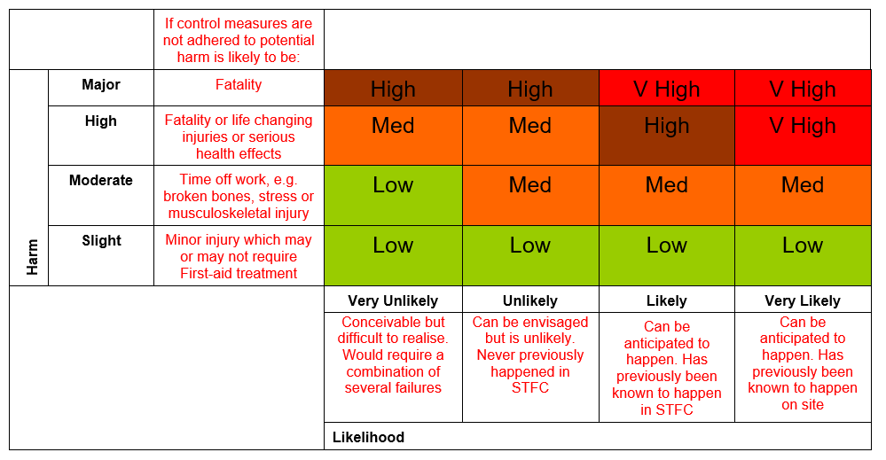
Priority matrix
  Risk is a function of both the harm and likelihood of a specific hazard being realised.

Slide 18
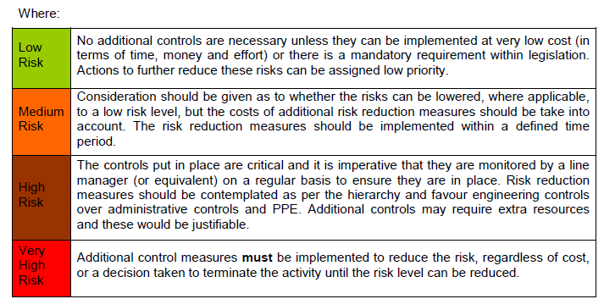
Definition of levels of risk

Slide 19
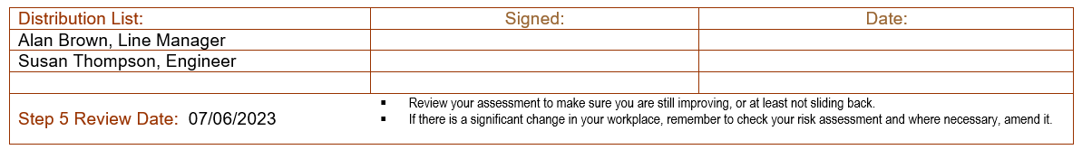
Monitoring and reviewing risk assessments
STFC policy is to review RAs every 2 years maximum. Sooner if there is an incident, e.g. near-miss or injury, a material change or if main assessor leaves STFC.
Develop an ongoing strategy, between reviews, to monitor your risks, e.g. meetings or key points in projects. Ask yourself, are any updates to the risk assessment necessary?
You can have the most wonderful risk assessments and policies in place but if they are not monitored and reviewed then they are worthless”
District Judge Taylor, Bristol Magistrates’ Court, July 2018

Slide 20
Action management

Slide 21
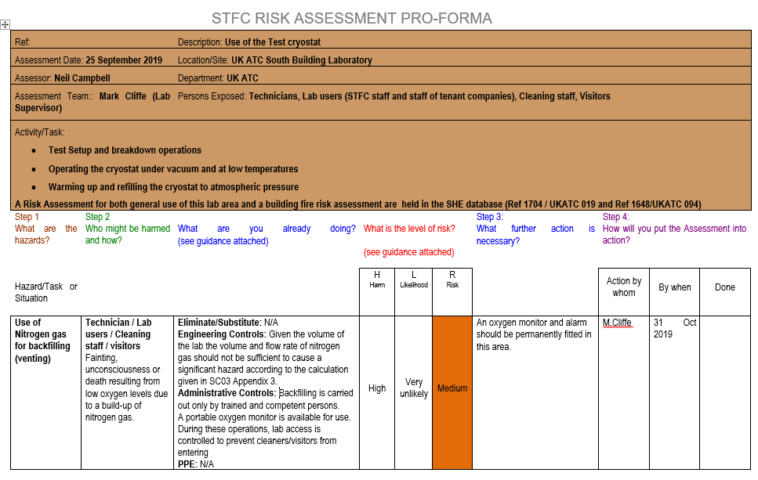
STFC Risk assessment proforma
Further actions (added to Evotix Assure when adding RA, separate tab)

Slide 22
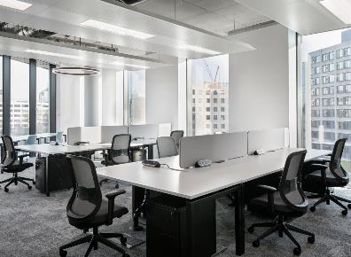
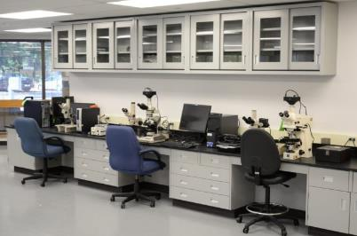
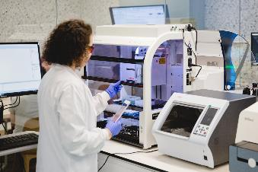
Common questions
When should I perform a generic risk assessment for a room with mixed use and when do I do a specific risk assessment for an activity?

Slide 23
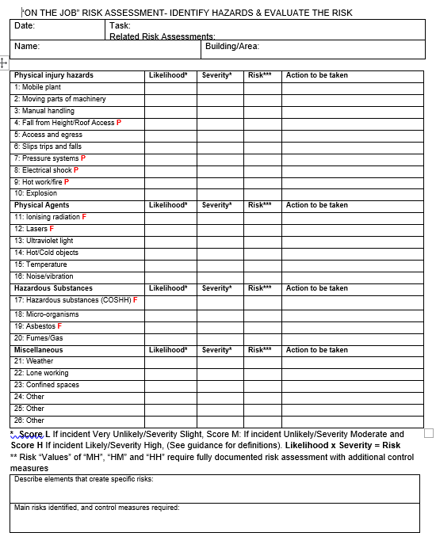
On the job risk assessment
For use when
  The task is a change or an addition to an existing planned activity
  A generic risk assessment needs to be adapted for a specific activity
Before starting the job, the assessor is required to STOP and THINK, can make use of a simple pro-forma designed to guide and record the risk assessment process
Part of this process is to check that a fully documented risk assessment is not required. If the work is deemed ‘high risk’ such as work at height, then work will require to stop until a full documented RA is written and signed off

Slide 24

HSE Guidance – is my RA suitable and sufficient
Have you included the 5 steps to RA?
Does risk assessment policy match what happens in reality?
Do you involve the workforce in the development of the RA?
  Asking for their views
  Seeking their suggestions
  Communicating RA to them once complete
Have control measures for the highest risks been incorporated into a regular monitoring scheme?
Should the implementation of control measures take time, have interim measures been put in place to minimise the risk?
New Appendix to the Code – Appendix 6 “Aide Memoire for the production of a “suitable and sufficient” RA

Slide 25
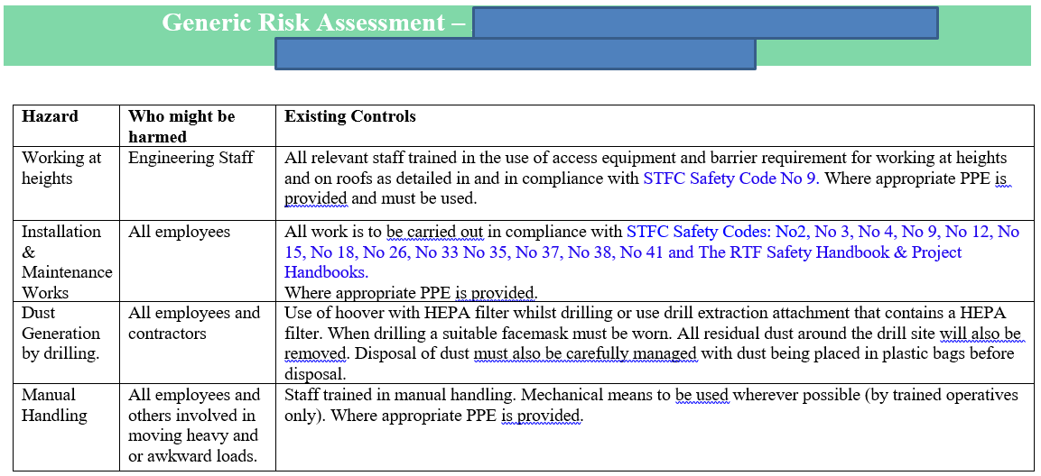
Imagine this live risk assessment is for your mechanical workshop. Are you happy?
Notes:
Notes on bad example:
Not on STFC proforma
No heading, i.e. brown box with key data such as main assessor, team, description of task, categories of people potentially impacted
Hazard description lacks details
No ‘how’ information in column 2
No separate controls for contractors
No control hierarchy in the existing controls column
No risk calculation
Links to SHE Codes as if this is a control measure. Could not expect a reasonable person to go away and read all these Codes prior to carrying out this activity.

Slide 26
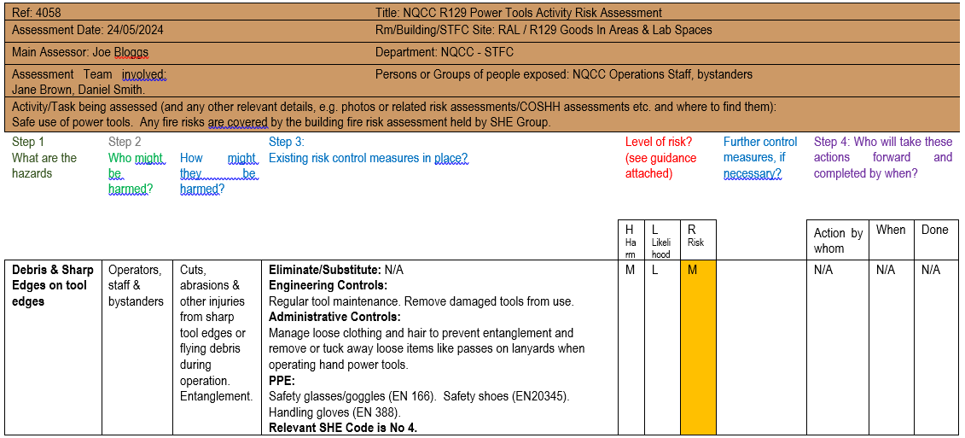
Better example performed by STFC staff

Slide 27
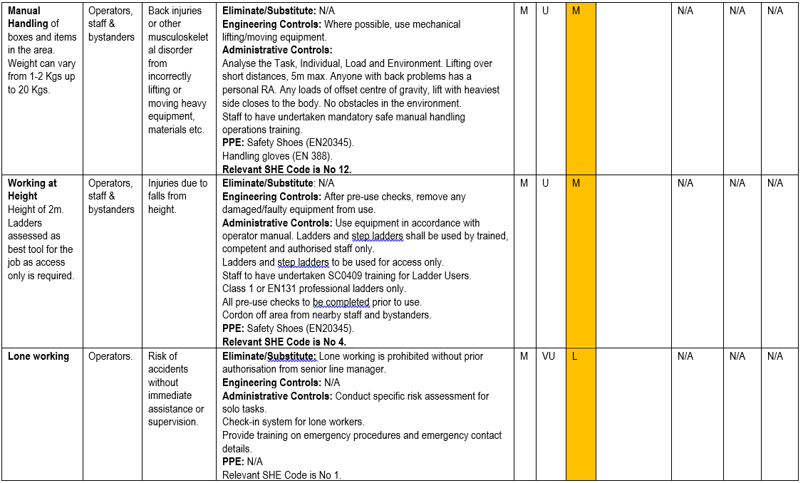

Slide 28
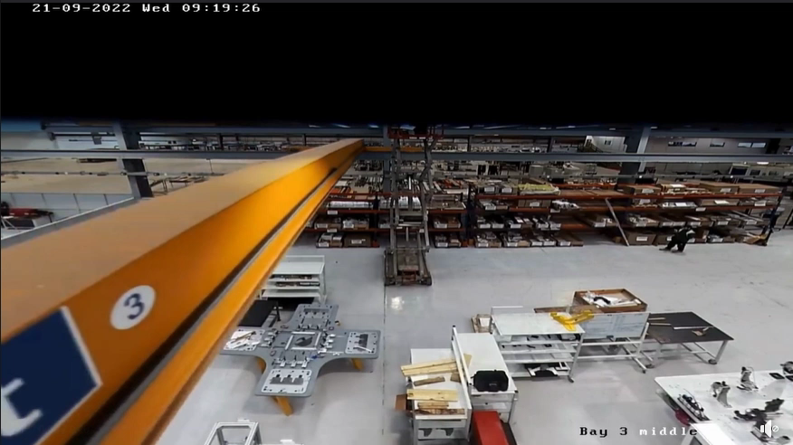

Firms fined for electrician's 35ft fall at Coventry manufacturers - BBC News
Both contractor and company where this took place were prosecuted and fined
£100 padlock would have prevented this contractor from being harmed
Notes:
- Occurred in late 2022. 52 year old contract electrician fell 35ft/10m onto a hard floor. They had been working on repairing a light fitting.
- The electrician sustained a fractured skull, two brain bleeds, a broken collarbone, eight broken ribs, a broken elbow and wrist as well as a punctured lung.
- He was later placed in an induced coma and underwent several operations.
- The contract company was fined £7K and the company whose site it was received a fine of £50K. Then would come the civil suit!
- A second staff member narrowly avoided being hit by the scissor lift falling.
- HSE found the contract company had not identified the operation of overhead cranes as a risk to its employee working at height.
- The company where it happened did not put procedures in place to prevent the use of overhead cranes while the work was taking place and relied on contractors identifying risks and implementing measures themselves.
- Both companies did not communicate with each other about how the work they were undertaking could impact safety.
- Crane should’ve had a Lockout/Tagout system in place for when anyone is working in its path.

Slide 29
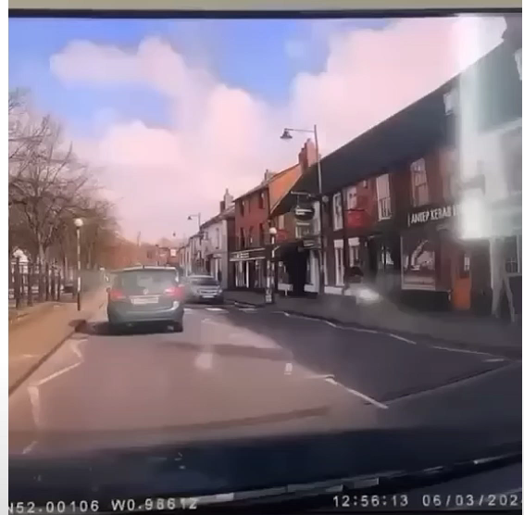
Scaffold tower collapse caught on car dashcam | Construction Enquirer News
Scaffolding Collapse into Oncoming Traffic, Buckingham UK (youtube.com)
Notes:
Occurred in March 2024.
Dashcam footage caught the moment an aluminium scaffold tower collapsed onto a road.
After the incident they re-erected the tower!!
Someone trained would have known the use of a tower in this situation was inadequate. Any structure would need to be attached to the building to prevent exactly this type of incident from taking place.

Slide 30
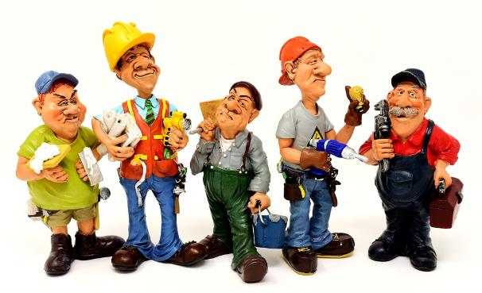
Method Statements (complex projects or working with contractors) “RAMS”
Task description
Known hazards
Responsible people
How projects will be monitored
Structure of tasks
Environmental issues
Permits
Competency of workers
Deliveries
Emergency Arrangements
See Appendix 7 of Code 6 for info on Method Statements and Safe Systems of Work

Slide 31

2016 Regime change: a new penalty landscape
In their first 6 months, the guidelines resulted in as many penalties of £1m or more as there were in the previous 20 years

Slide 32
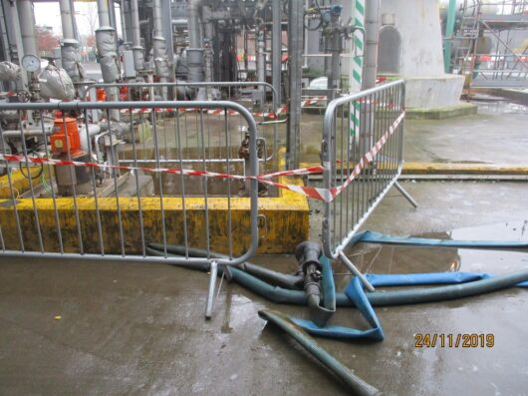
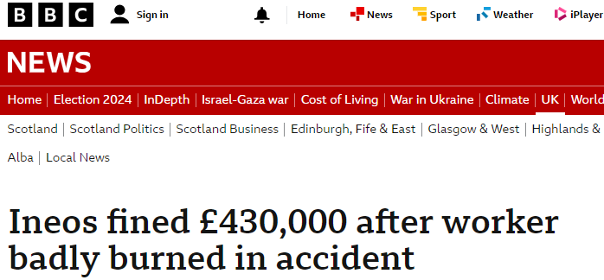
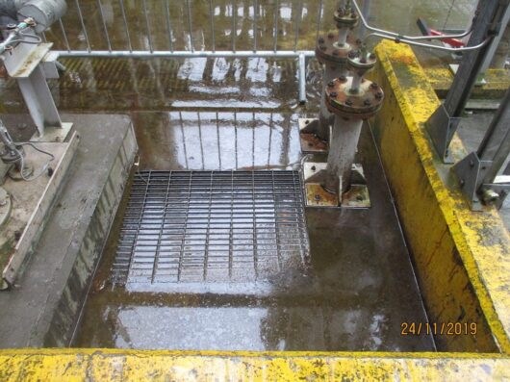
The worker, 47, was attempting to clear a sump that contained a caustic solution. However, he fell into the sump due to inadequate grating and sustained severe burn injuries. The sump had needed emptying as its contents had reached the high-level design threshold the day before.
No risk assessment had taken place for this activity.
There was also no safe system of work produced.
The grating was not secured and there were no barriers in place to prevent a fall into the sump.
Any risk assessment performed would have identified that the key risk was falling into the caustic solution and that current control measures were severely lacking!
Notes:
Incident took place in 2019 but prosecution did not take place until 2024.
Happened at Ineos’s chemical site in Grangemouth, Scotland.
Ineos Group are one of the world’s largest chemical producers and a significant player in the oil and gas market.
Man was taken to a specialist burns unit. Permanently scarred and in pain for a long time after the incident.
INEOS Chemicals Grangemouth Limited, pleaded guilty to an offence under Section 2(1) and Section 33(1)(a) of the Health and Safety at Work etc. Act 1974.

Slide 33
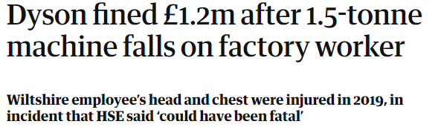


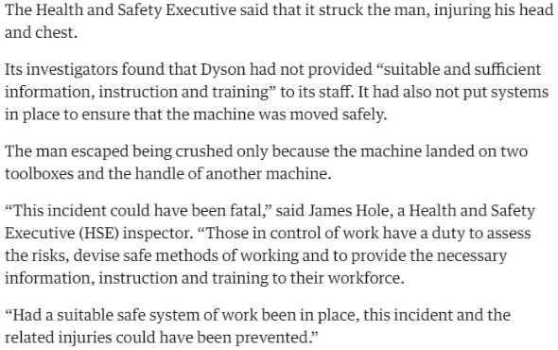
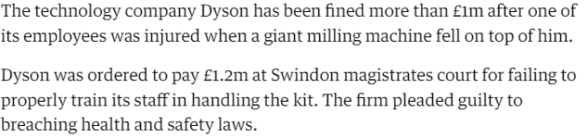



Slide 34
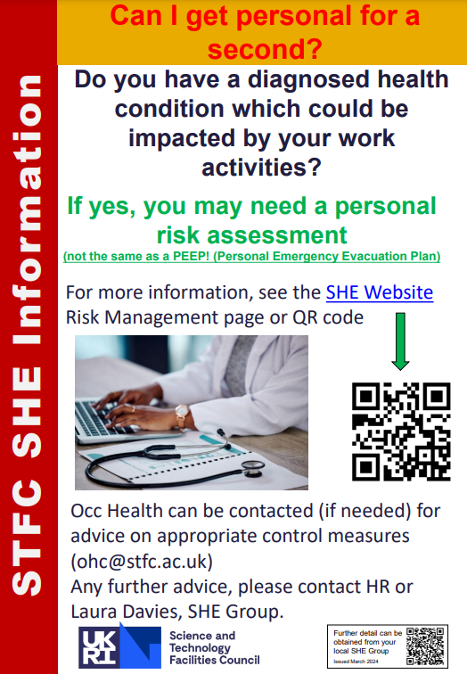
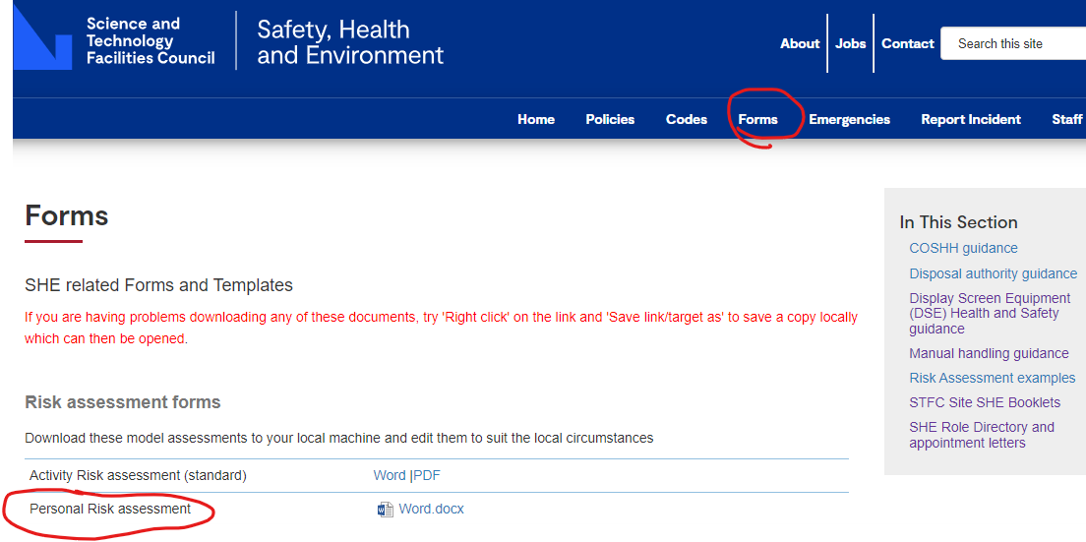
Personal Risk Assessment
  If a line manager becomes aware that one of their direct reports has a medical condition which could be impacted on by their work activities, e.g. epilepsy, severe allergy, eye condition, heart disease, etc. then the manager will need to carry out a personal risk assessment with the person.
  This could come from a discussion about time off for hospital appointments or a first aid incident on site. As soon as the line manager is aware, they have a legal duty of care to the direct report. The risk assessment demonstrates this duty of care has been fulfilled.
  You can find the proforma on the SHE website under ‘Forms’.
  If you need medical advice, you can refer them to Occupational Health.

Slide 35
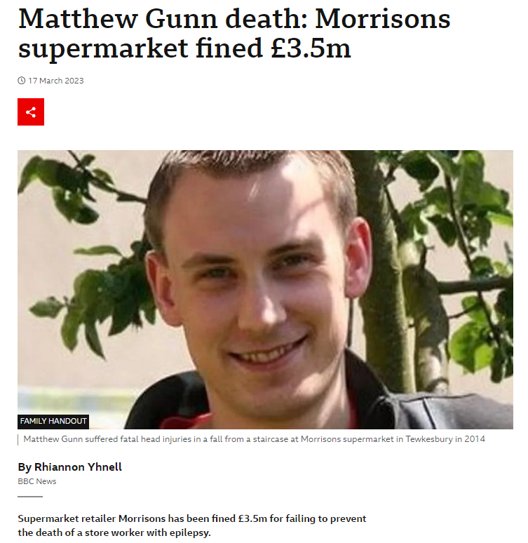
Lord Justice William Davis said:
“We accept that the staircase did not present a risk for almost all members of staff at the store. In our judgement that is not the point.
"It created a material risk to the health and safety of Matthew Gunn.”
Conclusion: STFC needs to assess the risks to staff where their health condition makes them more prone to injury.

Slide 36

Thoughts to leave you with….
Common problems with risk assessments:
Confusing hazard (potential) with outcome. Nothing painful in 1st column!
Failure to consult staff on preparation of RA or brief them on completion.
Not taking into consideration everyone potentially impacted by the activity.
Relying on a “generic” risk assessment when a “specific” one is needed.
Failure to complete the risk calculation correctly.
Insufficient information for high-risk activities. Level of detail should be proportionate to the risk.
Failure to take account of individuals’ requirements.
Lack of clarity on responsibilities – especially in matrixed projects.

Slide 37
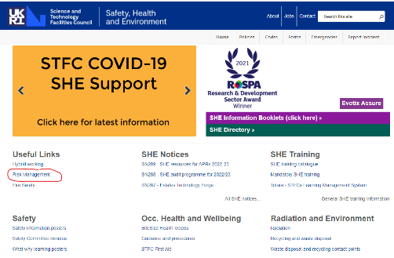
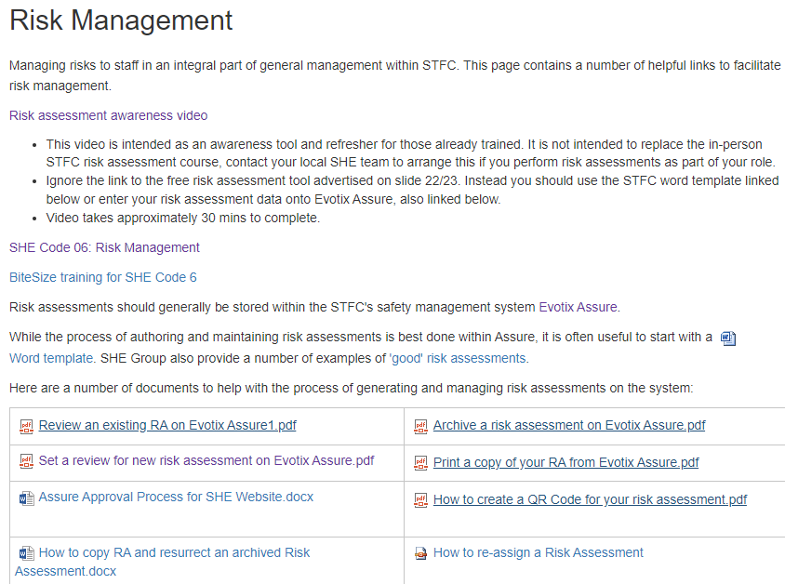
Dedicated risk assessment page
Please bookmark the SHE website on your PC/laptop, it’s a one stop shop for all SHE related topics:
https://staff.she.stfc.ac.uk/pages/staff/home.aspx

Slide 38
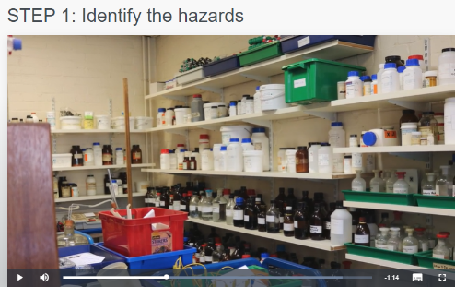
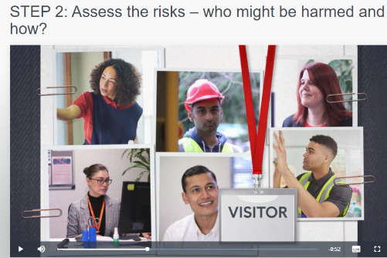
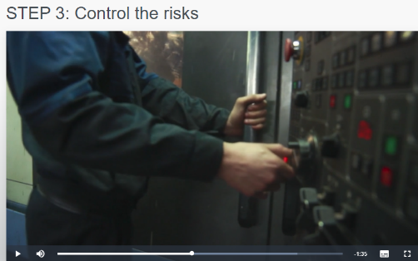
Risk assessment awareness

Slide 39
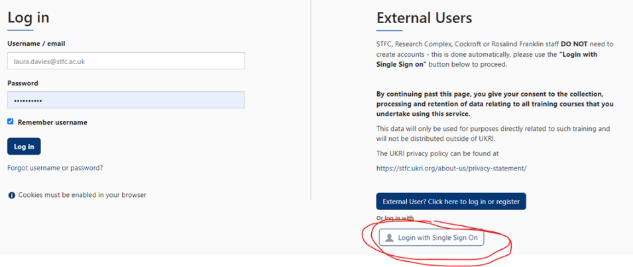
Logging onto Totara
Clicking on ‘Single Sign On’ will take you direct to your course when you follow a link
Having problems?
Ensure your VPN is connected.

Slide 40

Evotix Assure Videos
Risk Assessment

Slide 41
Instruction Videos
​​Video Tutorials
Evotix Tutorial 1 - Logging in with single sign-on​​​​
​​​​​Evotix Tutorial 2 - Dashboard and Navigation
Evotix Tutorial 3 - Searching for and finding records
​​Evotix Tutorial 4 - Creating a new risk assessment
​Evotix Tutorial 5 - Reviewing a risk assessment
​​​Evotix Tutorial 6 - Archive and re-open a risk assessment​

Slide 42

Risk assessment practical
Develop a risk assessment
The risk assessment can be:
  One developed for your own workplace
  One of the examples

Slide 43

Risk assessment review
Consider the adequacy of RA coverage in your work areas.
Consider the standard of RAs relevant to your area given the content of this morning’s sessions
Prepare a 5 minute presentation for the Chairman of your Departmental Safety Committee summarising your findings and making recommendations for actions

Slide 44
Thank you – Any questions
SHE website: https://staff.she.stfc.ac.uk/pages/staff/home.aspx

