Slide 1
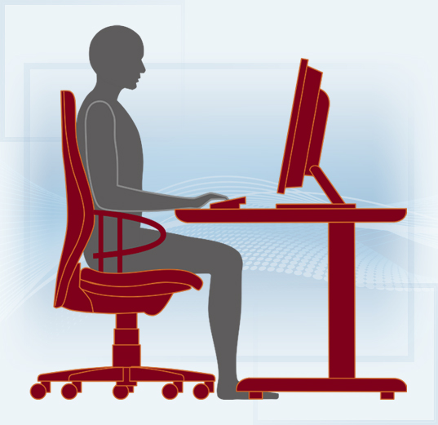
Setting up your workstation
Key Points
Poor posture can cause backache, upper limb problems, mental stress and eye strain
Ensure regular breaks are taken away from the desk to exercise eyes and body
To assist with stretches, watch the STFC short video of stretching exercises.
1. Adjust chair height until forearms are at right angles with upper arms
2. Adjust backrest height so that lower back (lumbar area) is supported. Should this not be possible, an additional lumbar support may be required.
START
3. Sitting in the seat, hips should touch the backrest and there should be a gap of 2-4 fingers from edge of seat to back of calf.
4. Adjust height of monitor so top of screen is at (or slightly below) eye level. Monitor should be about arms length from the body. Should not have to twist to view monitor(s).
FINISH
8. Position paper trays, etc. in accessible places to avoid over reaching or twisting.
5. Sit close to desk (elbows under shoulders) and keep keyboard and mouse close.
7. Position monitor at right angles to windows to avoid glare/reflections or close blinds.
6. Position frequently referenced documents at same height and distance as monitor.

